Slide 1
Introduction to the Solar System

Slide 2
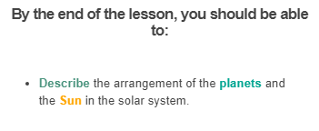

Slide 3
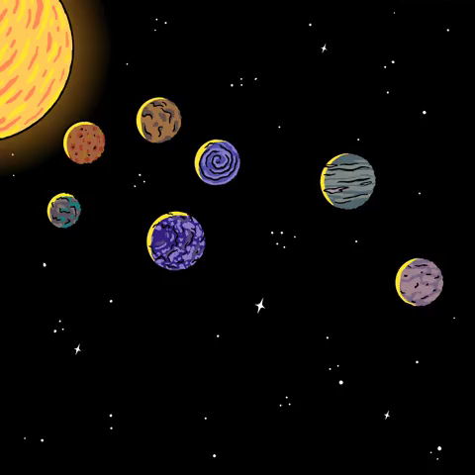
A planet is a very large, round object that floats around a star.
We call our planet Earth, but there are other planets that orbit the Sun.
There are even other planets orbiting other stars!

Slide 4
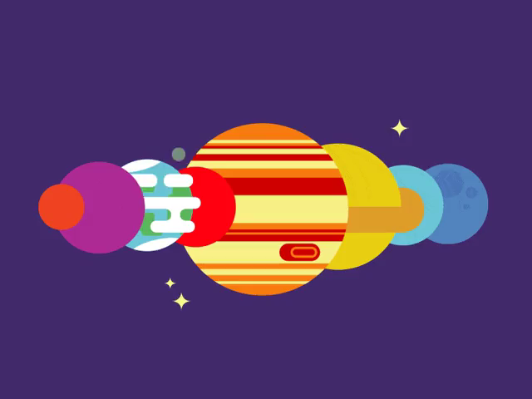
The collection of the Sun and the planets that orbit it is called the solar system.
There are also many smaller objects in the solar system, like moons and space rocks.

Slide 5
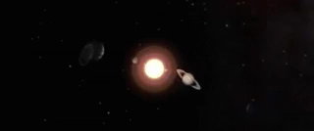
There are eight planets in the solar system.
The largest, Jupiter, is so big that over 1000 Earths could fit inside it, and the smallest, Mercury, is about one third of the size of Earth.

Slide 6
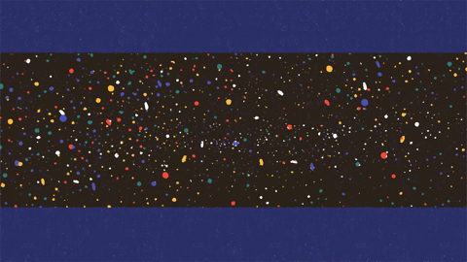
All of the other planets act differently to the Earth.
They have different orbits, they all spin at different speeds, and they all have different temperatures.
This is all because they are all closer to, or further away from, the Sun.

Slide 7
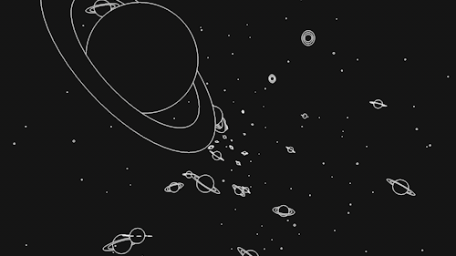
The area between the Sun and the planets is called space.
Space is an area that is filled with nothing. There is no air, no anything.
It is in space that the solar system floats.

Slide 8
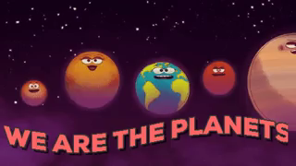
The solar system is made up of the Sun and all the planets that move around it.
Let's have a look at the eight planets of the solar system!

Slide 9
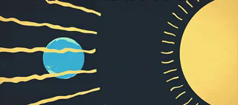
At the centre of the solar system is the Sun.
The Sun is a big, burning ball of gas. It makes a huge amount of light, which is what lights up the Earth during the day.
The light from the Sun also warms the planets - without the Sun, Earth would freeze!

Slide 10
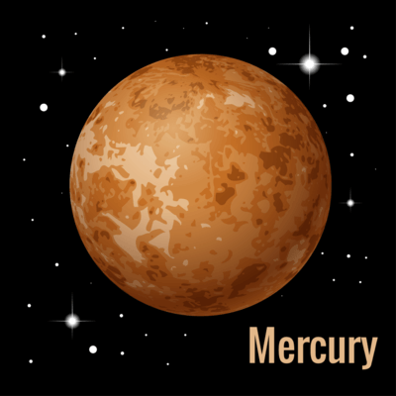
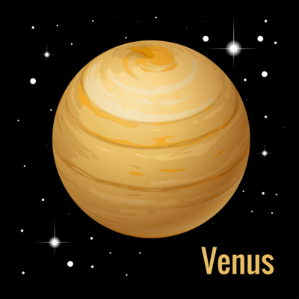
Mercury and Venus
The closest planet to the Sun is Mercury. It is the smallest planet in the Solar System, and is a barren rock with no atmosphere. It is called a "terrestrial planet" due to being made mostly of rocks, much like the Earth.
Between Earth and Mercury is the terrestrial planet Venus. Similar in size to Earth, Venus is incredibly hot and has an atmosphere of poisonous gases. Probes that enter its atmosphere are quickly crushed by the extremely high surface pressure.

Slide 11
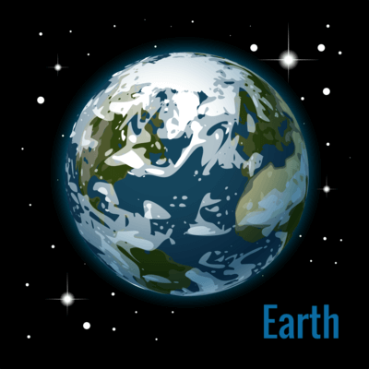
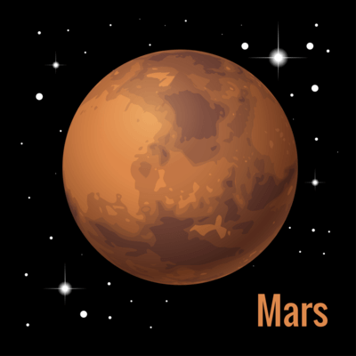
Earth and Mars
Earth is the third planet from the Sun. It is the only planet known to have life, which is thought to have developed due to its ideal distance from the Sun, magnetic field, liquid water and atmosphere.
Mars, the fourth planet, is smaller and colder than Earth. Known for its red surface, Mars is thought to have once been more like Earth, with water and maybe even life, but the water is now frozen and the surface is a cold wasteland. Mars is also terrestrial.

Slide 12
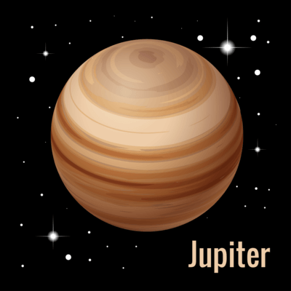
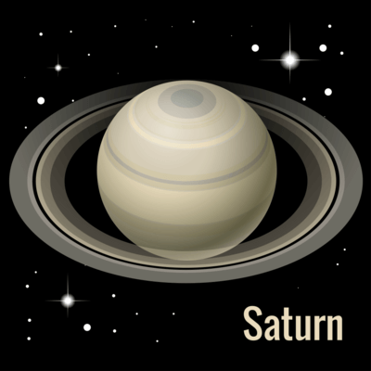
Jupiter and Saturn
Beyond the asteroid belt, we find Jupiter, the fifth planet. Jupiter is the largest planet in the Solar System, and is mostly made of gas. We call planets of its type "gas giants". Jupiter is well known for its Great Red Spot, a storm that has raged continuously for over 350 years.
After Jupiter is Saturn, the sixth planet. Saturn is another gas giant, well known for its giant rings of ice and rock. While they look solid, they are actually made from tiny dust particles.

Slide 13
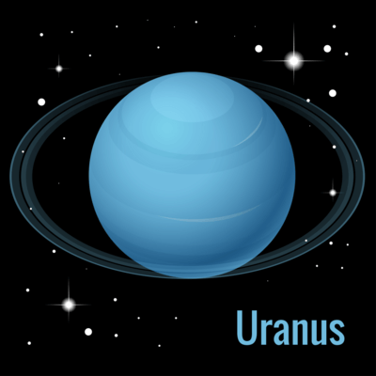
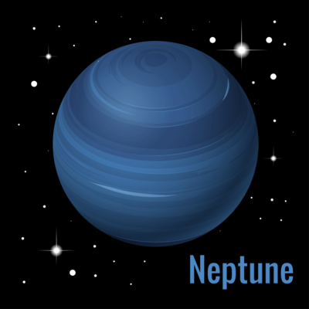
Uranus and Neptune
The seventh planet is Uranus, the first and largest of the two "ice giants". Ice giants are similar to gas giants, but are made mostly of heavier elements, such as oxygen and nitrogen. Uranus rotates on its side, making it look like it is rolling around the Sun.
Neptune, the eighth planet and other ice giant, has a deep blue colour and must be viewed with a telescope due to its distance from the Earth.

Slide 14
You can use a mnemonic to help you remember the order of the planets.
A mnemonic is a phrase you can use to remember a list using the first letter of each word. Our mnenomic for the planets is:
"My Very Educated Mother Just Served Us Nachos."
Mercury, Venus, Earth, Mars, Jupiter, Saturn, Uranus and Neptune.

